Slide 1


Archive device
Structure of the archive and its principle of operation

Slide 2
Three rings of recording
With certain settings TRASSIR software allows to record a main video stream, preferred stream and substream to HDD.
If there are many HDDs in the system, TRASSIR software will alternate HDDs depending on the load on each.
Main stream
Substream
is a high quality video data used for detailed viewing of the video signal coming from the camera.
is video data of low quality (compared to the main stream), used in cases when signals from a significant number of cameras need to be displayed on the screen at the same time.
In this case, good video quality is not required to display camera signals. When you switch from general scene viewing to detailed viewing of the selected scene, you will be automatically switched from the substream to the main stream.
Using a substream allows you to significantly reduce the load on the server and network (in case of connecting to the TRASSIR server via the network using TRASSIR client).
Preferred stream
are special local channels for which a different archive depth of the main stream is set. Such channels are grouped in a separate folder called ‘Privileged channels’.

Slide 3

Main stream
Record distribution on HDD
Preferred stream
Substream
Stream is not being recorded
The main stream and preferred video stream on HDDs are recorded by n-1 algorithm, i.e. the sub-stream is always recorded on a separate HDD.
The number of involved disks will also depend on the number of channels on the server:
1-4 channels - recording goes to 1 HDD.
5-9 channels - recording goes to 2 HDD.
10-14 channels - recording goes to 3 HDD.
15+ channels - recording goes to 4 HDD.
If you add an additional disk, it will be recorded along with the rest, filling up gradually. You should not expect a sharp increase in the archive depth, especially if the archive depth is large.

Slide 4
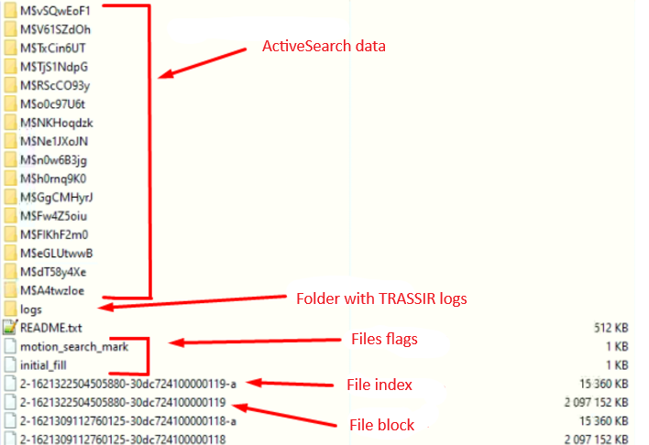
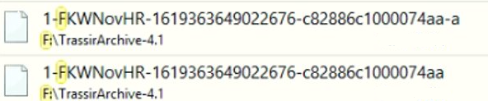
Structure of the archive and the principle of its operation
A folder named TrassirArchive-*.* is created in the root of each HDD or HDD partition.
All information from cameras is saved to this folder.
TRASSIR software archive has a certain structure: the archive folder contains a number of files, and each of those is responsible for a certain functionality of TRASSIR software:
Archive blocks and indexes; Archive flags; ActiveSearch metadata.
The synchronized archive blocks look a little different, with the Guid channel labeled:

Slide 5

Archive blocks and indexes
Archive blocks serve as cells for storing video streams of connected cameras to TRASSIR software. Accordingly, TRASSIR software archive consists of block files (2GB each) and index files (15mb each).
Block files store information from all cameras connected to TRASSIR software.
The index file contains information about date, time, and which camera owns which frames (frames).
The principle of file naming is structured as follows:
1-1400854021042033-e77431c100006cb3
1-1400854021042033-e77431c100006cb3-a
Where:
"1" record ring number (1 main, 2 preferred, 3 substream)
"1400..." time stamp (Unix time in microseconds)
"e77..." disk hash
"006cb3" disk block number
"-a" index feature ("afterblock")

Slide 6
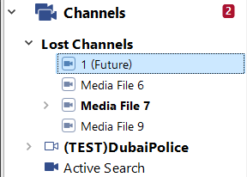
Prefixes
Also, the prefix "-a" and "-f" indicate the time when the block was written to the archive,
i.e. index "a" indicates that the block was written to the archive in the present time,
and index "f" - indicates that the block was written to the archive in the future.
This is possible when the clock on the server is set to earlier time.
This is a normal reaction of TRASSIR to abnormal behavior of the system.
Blocks with prefix "f" in the TRASSIR software interface will be located in "lost channels" and will be named "channel name (future)".
If the time has been transferred several times on the server, the archive blocks,
that already had the "f" prefix may be unreadable.
In such a situation it is necessary to contact technical support.

Slide 7
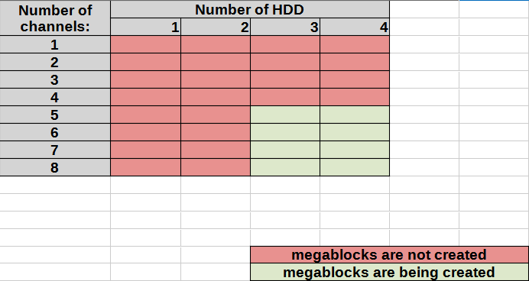
Megablocks
"Megablocks" - several archive blocks with a common index file, i.e. each disk has an index file containing information about other blocks included in this "megablock".
Using "megablocks" allows to increase the speed of work with archive blocks and more evenly distribute (reduce) the load on the server and alternate HDDs depending on the load on each.
This is achieved due to the fact that after reading one "megablock" index file TRASSIR software operates with several archive blocks, which are located on different server HDDs.
Creation of "megablocks" is affected by the number of channels and the number of HDDs connected to the server.
In a situation when the system (server) has 5 channels and 3 HDDs, "megablocks" will be created:

Slide 8
Archive flags
Motion_search_mark - flag indicating on which HDD ActiveSearch metadata is stored
(ActiveSearch is TRASSIR video analytics software that allows you to search for the presence of movements in a user-specified area of the frame).
This flag should be only on one HDD (if this HDD was not disconnected and analytics recording was not performed on another HDD).
Initial_fill - is the flag responsible for filling HDD with archive files.
The archive rewrite cycle will start automatically under the following conditions:
when there is 2GB of free space on HDD without ActiveSearch metadata (i.e. without motion_search_mark flag);
if there is ActiveSearch metadata on HDD, the archive rewrite cycle will start at 12GB of free space on HDD or less, depending on the conditions.
The initial_fill flag is deleted when the overwrite cycle starts.
README.txt file - this file is not a flag. TRASSIR software uses this file to determine whether read and write permissions to the archive folder are available.
Format_mark - this flag is present only in TRASSIR OS. It indicates that HDD is formatted and ready for recording an archive. If this flag is removed, it will be possible to format this HDD on TRASSIR OS.

Slide 9
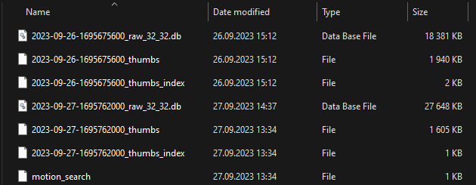
ActiveSearch Metadata
The archive structure includes folders that contain metadata for ActiveSearch video analytics.
Folder names contain "M$" prefixes and channel GUIDs. Folder contents: :
Accordingly, the folders contain ActiveSearch metadata files.
The name of the metadata file reflects the date of the event and its time in Unix time format.
When removing HDD with ActiveSearch metadata (e.g. disk 1) TRASSIR software will start writing new ActiveSearch metadata to any other HDD (e.g. disk 2).
When the previously seized disk (disk 1) is returned to the system, TRASSIR software will operate with ActiveSearch metadata of the previously seized HDD (i.e. disk 1) again.

Slide 10
Recording rate
When using a large number of cameras it is necessary to take care of the speed of recording the archive on HDD.
Archive recording speed in TRASSIR software:
HDD quantity | fragmented HDDs | unfragmented HDDs
1 | 4 mB/s | 25 mB/s
2 | 5 mB/s | 50 mB/s
3 | 15 mB/s | 100 mB/s
4 | 20 mB/s | 150 mB/s
5 | 25 mB/s | 200 mB/s
6 | 25 mB/s | 200 mB/s
7 | 25 mB/s | 200 mB/s
8 | 25 mB/s | 200 mB/s
The longer the operation time of TRASSIR software, the faster you can work with the archive.
This is due to the fact that TRASSIR software stores information about the name and location of index/block files in the cache/buffer during its operation.

Slide 11
Disk 1
Disk 2
Disk 3
We recommend using HDDs of the same capacity because the archive in TRASSIR is written evenly and tries to align each of the disks, this is necessary so that in case of failure of one of the HDDs we don’t lose a significant part of the archive of any day.
More Information
Moe Information

Slide 12
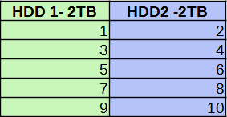
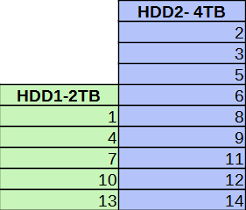
When designing a server, it is worth considering the capacity of the HDDs used.
Let's consider a situation when 2 HDDs of 2 TB each are allocated for the archive recording.
Archive blocks will be distributed evenly in such system:
Why is it important?
Below are a number of examples and situations to avoid, when designing and setting up a video surveillance system.
When there are 2 HDDs in the system, but one disk is 2TB and the second disk is 4TB, TRASSIR software starts thinning-out, thus increasing the load (read/write) on HDD of a larger volume.

Slide 13
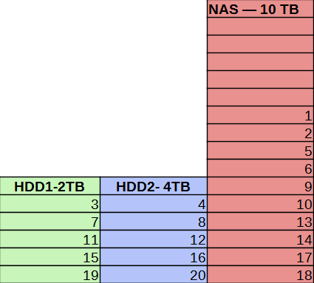
Why is it important?
When using multiple 2TB HDDs in the system. (e.g. 2 HDDs) and a 10TB NAS (network attached storage), this configuration is not recommended.
With such a big difference in volume between HDD and NAS, there will always be free space on NAS.
This is caused by the fact that TRASSIR software tries to align the archive across all disks.
Accordingly, this configuration is not feasible.
To ensure normal operation of the archive using a NAS of large volume, it will be necessary to create logical partitions on it with the volume approximately equal to the volume of HDDs used in the system, or using a RAID controller to combine all local HDDs on the server into a partition of the same volume as on the NAS.

Slide 14
C.
ERROR_SECTOR_NOT_FOUND
sector not found: probably there are damaged sectors on HDD.
B.
disk space not available
D.
(error 1117) cannot write
This error occurs when TRASSIR software for some reason cannot allocate free space for creating an archive block
C
The request was not executed due to I/O error on the device.
This error can be caused by insufficient write permissions on HDD or incorrect settings in TRASSIR software (e.g. all HDDs are enabled read-only).
B
D
A
E
Examples of HDD errors in TRASSIR software
A.
disk too slow
E.
boost::file::system::rename
This error occurs in situations when HDD recording speed is insufficient for recording video stream. TRASSIR software reports this error when the size of the buffer allocated for the archive block exceeds 500mb. Accordingly, as soon as the buffer overflow occurs, the information is lost and the archive of this time period will be missing.
Unable to read the block/ someone deleted the archive block manually

Slide 15
To summarize,
we can highlight
01
03
With certain settings TRASSIR software allows to record a main video stream, preferred stream and substream to HDD.
If the number of HDDs in the system is large, TRASSIR software alternates between HDDs depending on the load on each of them.
The archive in TRASSIR is written evenly and tries to align on each of the disks. This is necessary, so that in case of failure of one of the HDDs we don’t lose a significant part of the archive for any day
02
04
TRASSIR software archive has a certain structure, the archive folder contains a number of files, and each of those is responsible for a certain functionality of TRASSIR software:
Archive Blocks and Indexes; Archive Flags; ActiveSearch Metadata.
The archive structure includes folders that contain metadata for ActiveSearch video analytics. This speeds up the process of searching for the required event in the archive.

Slide 16

Thank you for your attention!

